Slide 1
Session Two and Three (Chapter Two) HRM Practices and Policies

Slide 2

Management is the (process) (Art/ Science) of getting things done through others (Men/Human) by using resources and all other Tools for achieving individual, organizational and societal Objectives.
Resources: (Physical, Capital, Human, Technology, Information)

Slide 3
Human Resources Management (HRM)
M+R+H
Management
Resources
Human
(Management of Resources of Human)
Again,
(MANAGEMNT)/HRM
Manage+Men+T
Man + Age + Men + T (Tactfully)

Slide 4
Why only Manage Men ?
Among the 6 Ms (Men, Machines, Materials, Money, Method and Market)
"men" is not so easy to manage.
"every man is different from other"
men possess the power to manipulate the other M(s).
Whereas, the other M(s) are either lifeless or abstract and as such, do not have the power to think and decide what is good for them.

Slide 5
Human Resource Management
Gary Dessler Said-
“HRM is the process of acquiring, training, appraising, and compensating employees, attending to their labor relations, health & safely, and fairness concerns.”
He also said that “HRM refers to the practices and policies one needs to carry out the people or personnel aspects of management job.”

Slide 6
Human Resource Management
The process of attracting, developing and maintaining a talented and energetic workforce to support organisational mission, objectives and strategies.

Slide 7
GOLDEN PRINCIPLES OF HUMAN RESOURCES
Your most valuable asset is your precious human resources. Make sure employees go home happily and return to the office with excitement.
“Take away my people, but leave my factories, and soon grass will grow on the factory floors. Take away my factories, but leave my people, and soon we will have a new and better factory.” —Andrew Carnegie.

Slide 8
PRINCIPLES OF HUMAN RESOURCES
Principle #1: Recruitment to retirement.
(If there is no HR who will recruit employees? )
Principle #2: People (men) behind the machine count.
There is a limit to machines, but there is no limit to human potential. Elbert Hubbard rightly remarked, “One machine can do the work of 50 ordinary men. No machine can do the work of one extraordinary man.”
Principle #3: Hire for attitude, recruit for skills.
It is better to hire a new job seeker with high attitude and no experience, than one with a rotten attitude and years of experience. ATTITUDE=100% (1+20+20+9+20+21+4+5=100)
Principle #4: Appreciate attitude but respect intelligence.
It is true that both attitude and intelligence are essential to improve the organizational bottom line - Elton Mayo

Slide 9
Principle #5: Hire slow, fire fast.
If you find that bad apples entered into their basket, you must be removed quickly to contain further damage to their organizations.
Principle #6: Most Valuable Asset
Renee West once said, “You can have the best strategy and the best building in the world, but if you don’t have the hearts and minds of the people who work with you, none of it comes to life.”

Slide 10
Hard and Soft Model of HRM
Hard HRM Treats employees simply as a resource of the business (like machinery & buildings). Short-term changes in employee numbers (recruitment, redundancy) Minimal communication, from the top down Pay – enough to recruit and retain enough staff (e.g. minimum wage) Little empowerment or delegation Appraisal systems focused on making judgements (good and bad) about staff Suits autocratic leadership style | Soft HRM Treats employees as the most important resource in the business and a source of competitive advantage. Strategic focus on longer-term workforce planning (Health) Regular two-way communication Competitive pay structure, with suitable performance-related rewards (e.g. profit share, share options) Employees are empowered and encouraged to seek delegation and take responsibility Appraisal systems focused on identifying and addressing training and other employee development needs Suits democratic leadership style

Slide 11
Which is best? Soft or Hard HRM?/ Outcomes of soft or hard HRM
Which of the two approaches is better? The answer is – it depends!
The "hard" approach to HR might be expected to result in a more cost-effective workforce where decision-making is quicker and focused on senior managers. However, such an approach pays relatively little attention to the needs of employees and a business adopting a genuinely "hard" approach might expect to suffer from higher absenteeism and staff turnover and less successful recruitment.
The "soft" approach will certainly appeal to the "touchy-feely" amongst us who like to see people being treated nicely! And you can also make a good business case for an approach that rewards employee performance and motivates staff more effectively. However, the danger of taking too "soft" an approach is that when all the employee benefits are added up, the cost of the workforce leaves a business at a competitive disadvantage.

Slide 12
HRM scope/areas/aspects/subject matters
Employment Issues
Recruitment
Selection
Induction / orientation/socialization
Training and professional development
Performance appraisal management
Career development
Quality of work life
Retention and turnover
Employee Issues
Discrimination,
Equal employment opportunity
Harassment
Affirmative action
Diversity/change management
Occupational health and safety
Industrial relations

Slide 13
Current Issues In HRM
Sexual harassment
Workplace romance
Work life balance
Controlling HR cost
Burnout - chronic emotional and interpersonal stress
Value of Human Resource
Competitive advantage

Slide 14
Functions of HRM (BASIC)
DEVELOPMENT (Preparing)
Employee Training and Development
Management Development
Career Development
MOTIVATION (Stimulating)
Job Design
Performance Evaluations
Rewards
Job Evaluation
Compensation/Benefits
Discipline
Maintenance
(Keeping)
Health, Safety and Security
Employee/Labour Relations

Slide 15
Functions of HR
MANAGERIAL FUNCTIONS
Planning
Organizing
Staffing
Controlling
OPERATIVE FUNCTIONS
Staffing
Development
Compensation
Motivation
Maintenance
Integration

Slide 16
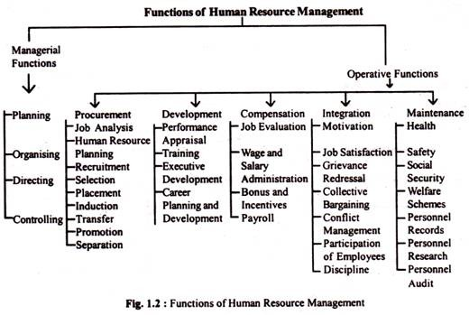

Slide 17
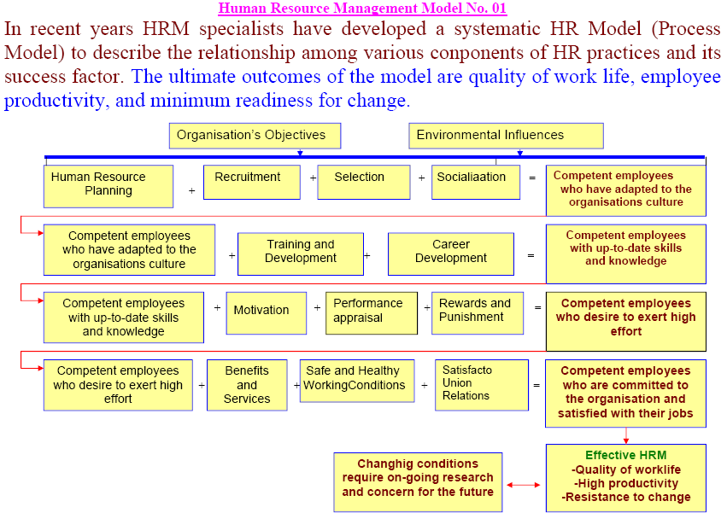

Slide 18
POLICY
Guidelines of an action !!!!!!
Policies are usually made by top management and provide a broad framework within which an organization and the workforce perform all the activities.

Slide 19
HRM Policy
HRM policies define the guidelines, philosophies and values of an organization about how people will perform their activities in specific areas and how they will be treated.

Slide 20
Qualities of Good Human Resource Policy
Specific (SMART)
Measureable
Achievable
Realistic
Time frame
Written
Flexibility
Work-Life Balance

Slide 21
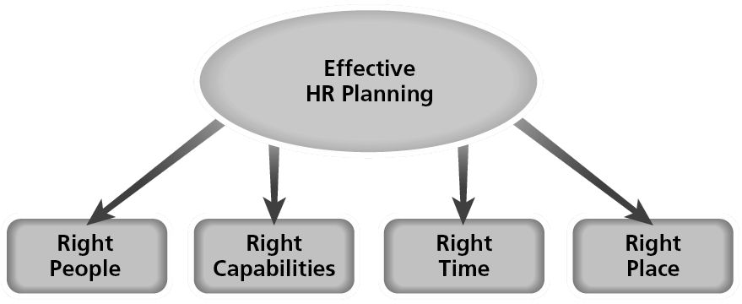
Human Resource Planning
Human Resources Planning (HRP)
Human resource planning involves having the right number and the right kind of people at the right place, at the right time, doing the right kind of task that result in long-run.

Slide 22
What is Job Analysis?
Job Analysis is the process of getting detailed information about jobs.

Slide 23

A job analysis is a the systematic explorations of the activities within a job.
.

Slide 24
Outcomes of Job Analysis
Job analysis process generates three outcomes:
Job descriptions
Job specifications
Job evaluation
.

Slide 25
Nature & Purpose of Job Analysis
Job Description A job description is a written statement of what the jobholder does, how it is done, under what conditions it is done, and why it is done. It is the employment requirement.
Job Description Contains the following:
Identification
Job title
Reporting relationships
Department
Location
Date of analysis
General Summary
Describes the job’s distinguishing responsibilities and components
Essential Functions and Duties
Lists major tasks, duties and responsibilities
Others:
Signature of approvals
Working Condition
Hazards

Slide 26
Example of Job Description
JOB TITLE:_____ OCCUPATIONAL CODE: ________
REPORTS TO:___ JOB NO. : ___________________
SUPERVISES:___ GRADE LEVEL: _______________
AS ON DATE :_________
FUNCTIONS: ______________________________________________________________________________________________________
DUTIES AND RESPONSIBILITIES: ______________________________________________________________________________________________________
JOB CHARACTERISTICS: ______________________________________________________________________________________________________

Slide 27
Nature & Purpose of Job Analysis
Job specifications:
The job specification states the minimum acceptable qualifications that the incumbent must possess to perform the job successfully.
A statement of human qualifications necessary to do the job. Usually contains such items as:
Education, Experience, Training, Judgment, Initiative, Physical Skills, Responsibilities, Communication Skills, Emotional characteristics, personality

Slide 28
Example of Job Specification
JOB TITLE: __________________________
EDUCATION:_________________________
PHYSICAL HEALTH: ________________________________________________________________________________________________________________________
APPEARANCE: ____________________________________________________________
MENTAL ABILITIES: _______________________________________________
SPECIAL ABILITIES: _______________________________________________
PREVIOUS WORK EXPERIENCE: ________________________________________________________________________________________________________________________
SPECIAL KNOWLEDGE & SKILLS:_____________________________________
OTHER : ________________________________________________________

Slide 29
Recruitment & Selection
The process of searching for appropriate employees and encouraging them to apply for jobs is known as Recruitment
The process of identifying and choosing the best person out of a number of prospective candidates for a job is known as Selection.

Slide 30






BUSINESS OBJECTIVES
HR PLANNING
JOB ANALYSIS
JOB DESCRIPTION
JOB SPECIFICATION
RECRUITMENT
SELECTION

Slide 31


Slide 32
Class Task – Individual – 15-20 minutes
From the example above, can you distinguish the job description and job specification? If yes, then prepare a job description and job specification (in separate tables). Assume any example (national / multinational organization).
Please write it on your notebook.

